Slide 1





Team: 01
My Policy Hub
AN ONLINE INSURANCE MANAGEMENT SYSTEM

Slide 2



Our Team
Ajit Beniwal Anubhav Bhattacharjee Katikireddy Shalini
Naveen Vijayakumar Valluri Venkatram
Under Guidance Of Mentor Pavithra Kannan

Slide 3

Overview
Introduction
Project Overview
Key Features
Tech Stack
Milestones
Database Schema
Front End Pages
Conclusion

Slide 4


INTRODUCTION
Project Overview: This project is a user-friendly web application designed to streamline insurance management, allowing customers to schedule appointments with agents, access insurance plan information, and manage appointments easily.
Core Functionalities: Key features include user authentication, agent availability management, plan information management, an appointment scheduling interface and an admin dashboard for efficient system oversight.
Outcome: This project aims to enhance efficiency and customer satisfaction by offering a seamless, accessible platform for managing insurance-related needs.

Slide 5


PROJECT OVERVIEW
KEY FEATURES
Authentication: Secure access for customers, agents, and administrators.
Insurance Plan Management: Easy comparison and selection of insurance plans.
Appointment Scheduling and Agent Selection: Simple tools to manage appointments
and connect with agents.
AI-Powered Health Cost Prediction: Predict potential health charges based on user
health data.
Administrative Tools: Centralized dashboard for managing platform operations.

Slide 6









TECH STACK
FRONT END: JSP, CSS, JavaScript.
BACKEND: JDBC, Servlets, Python.
SERVER: Apache Tomcat.
DATABASE : MySQL.
MACHINE LEARNING MODEL: Random Forest Regressor.

Slide 7



MILESTONES
01
02
03
04
Completed user authentication and registration, and initiated the implementation of agent availability management.
Completed agent availability management, fully developed the appointment scheduling interface, and started its backend integration along with other customer features.
Completed appointment management on the user end, integrated with the backend, and started implementing agent features.
Completed agent features and began working on the admin end, with the admin dashboard and AI-powered health cost prediction

Slide 8

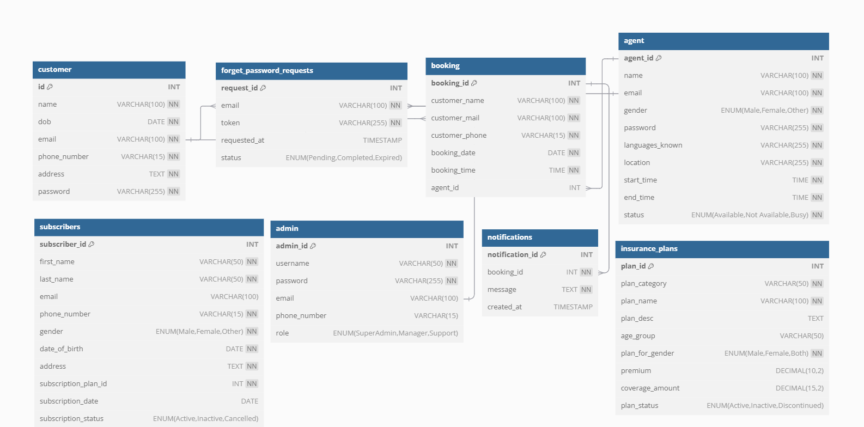
Database Schema

Slide 9

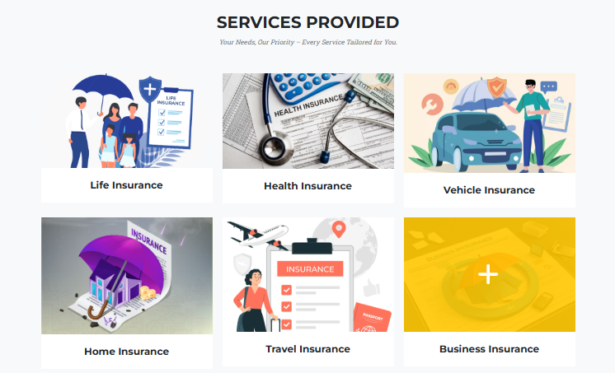

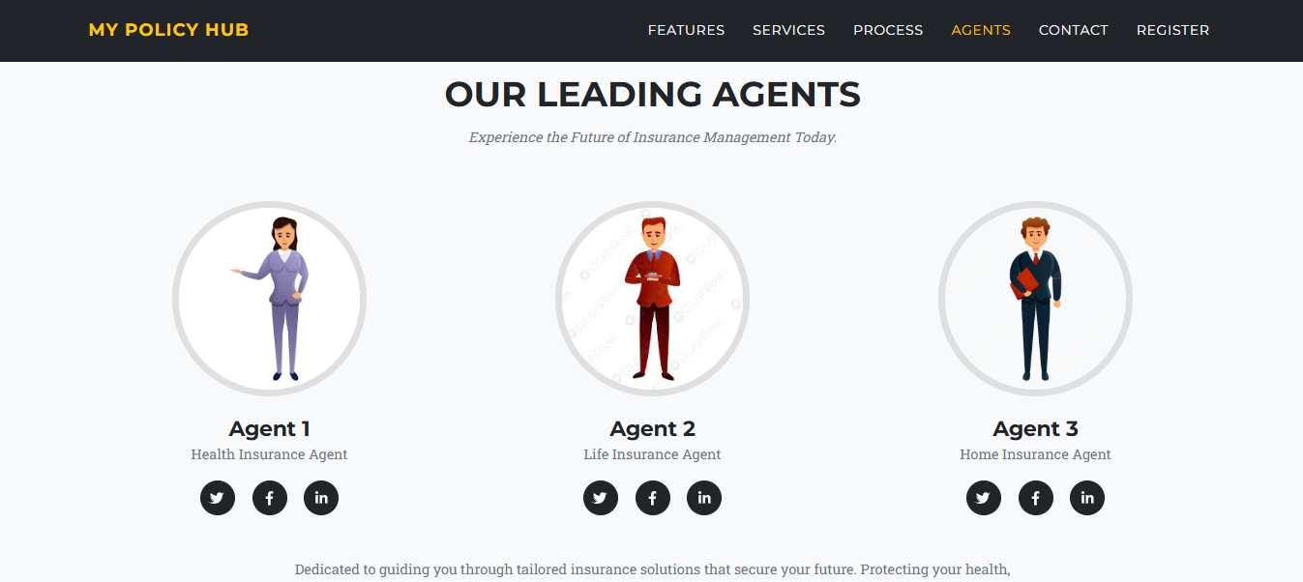
Landing Page

Slide 10
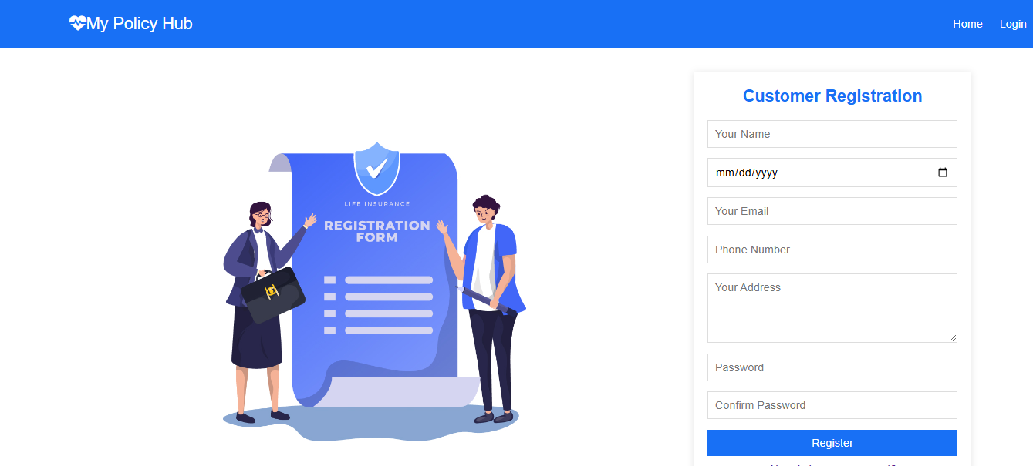
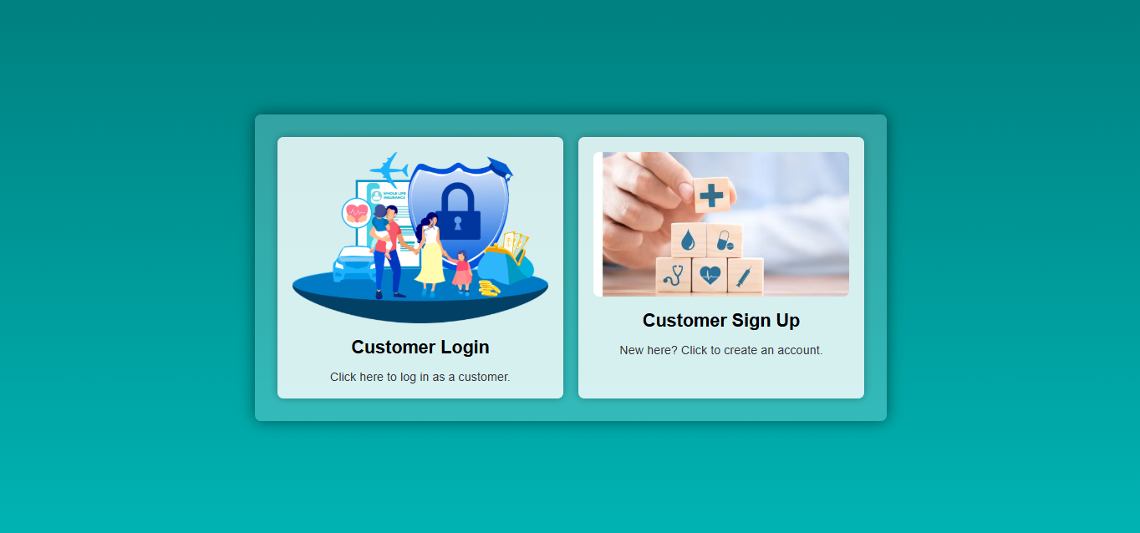
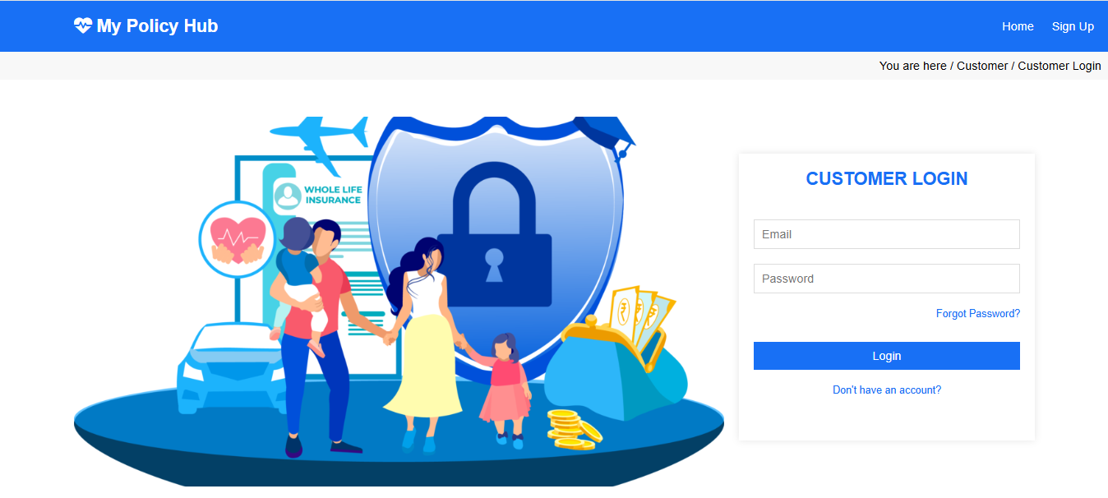
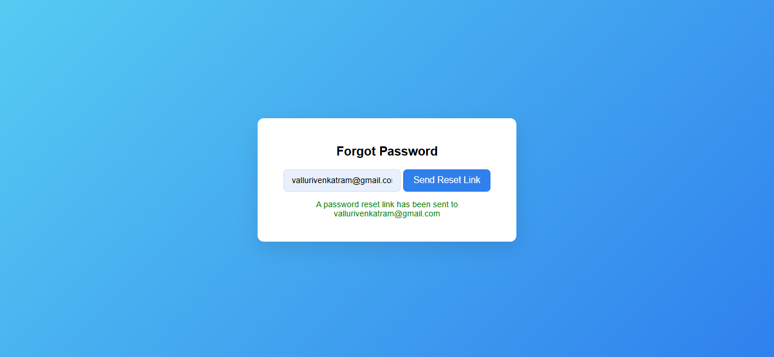
Customer End : Login / Registration

Slide 11
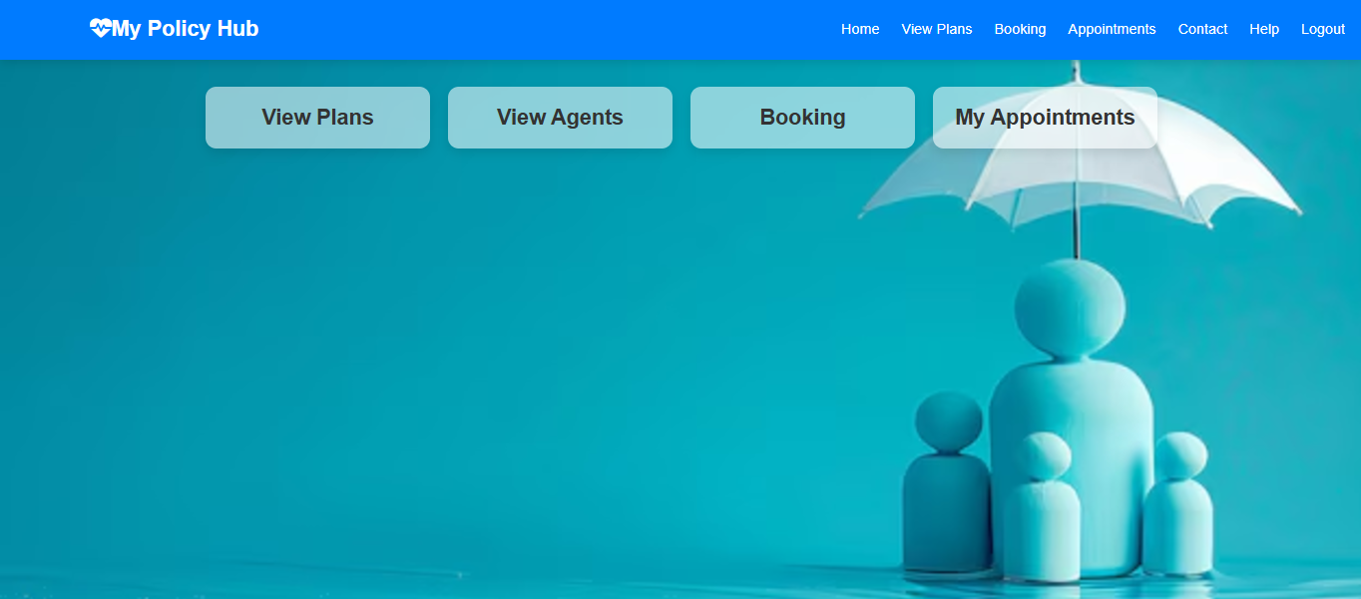
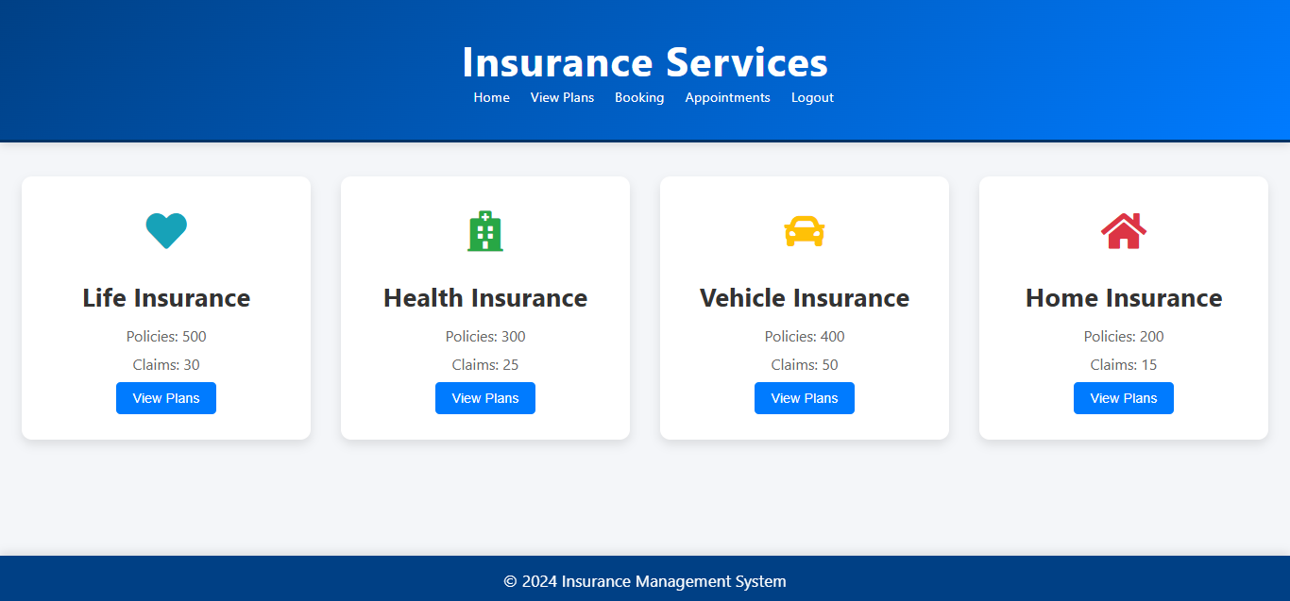
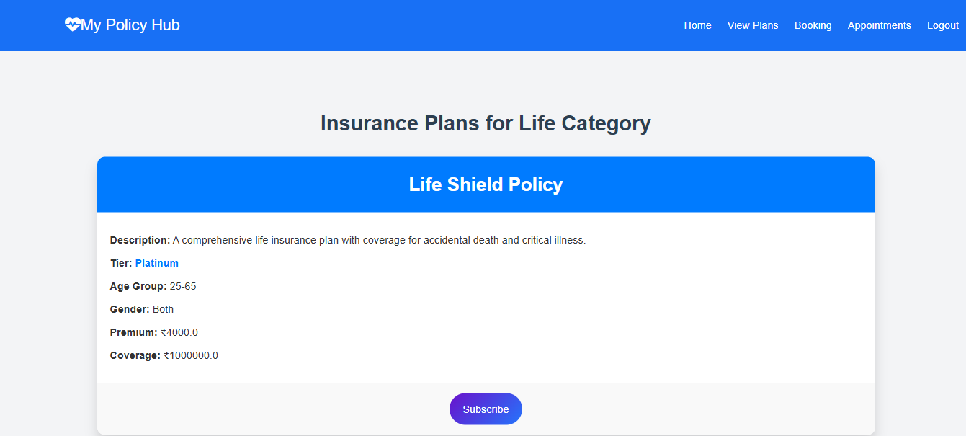
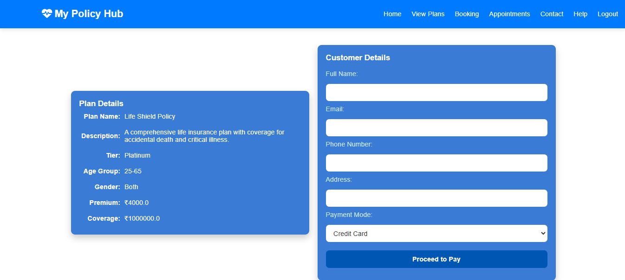
Customer End : Home, Services

Slide 12
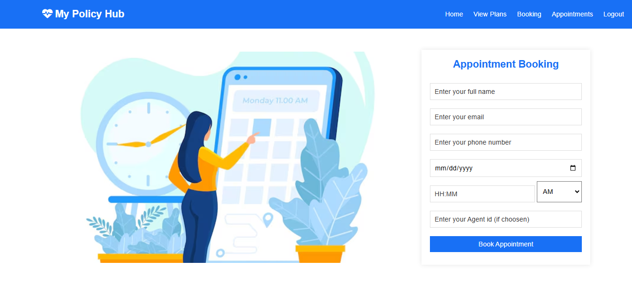
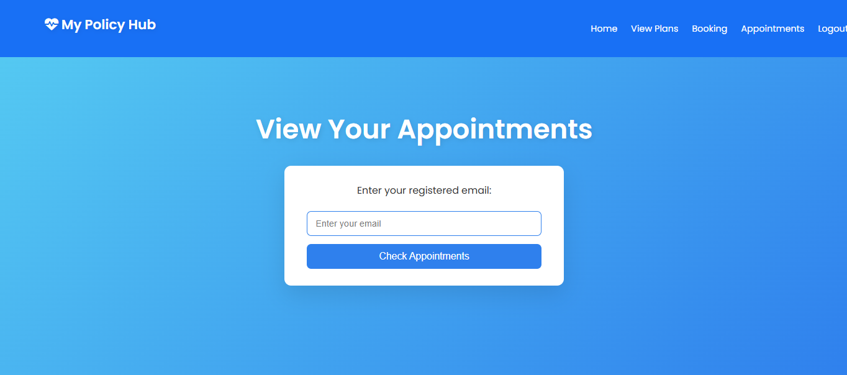
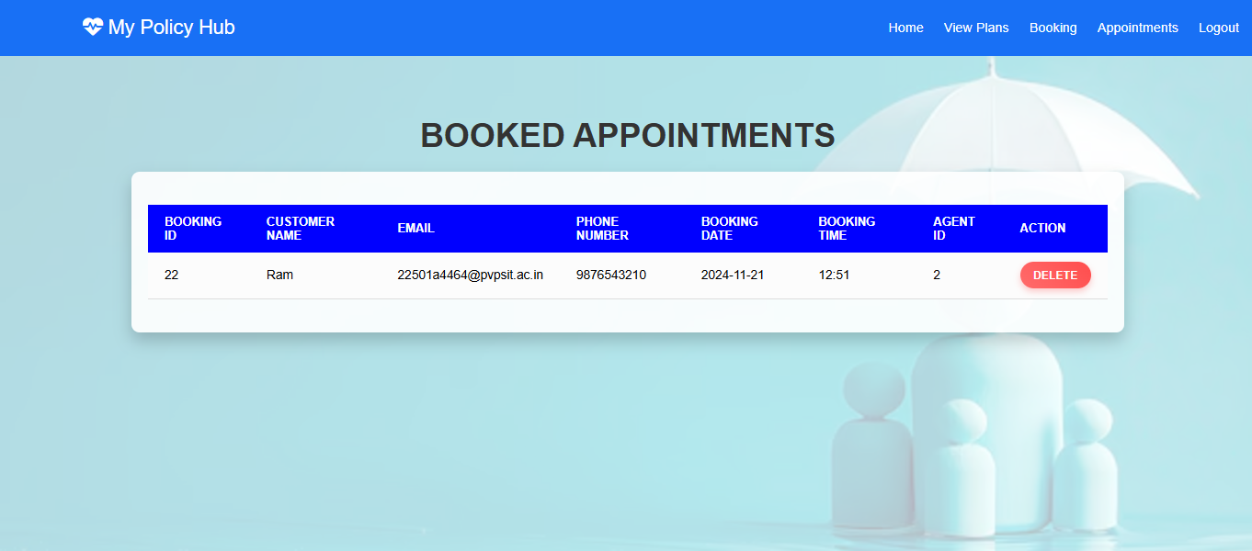
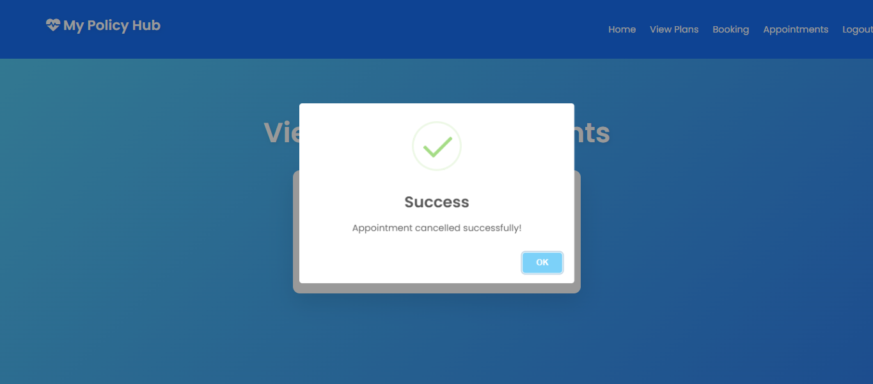
Customer End : Appointment Scheduling

Slide 13
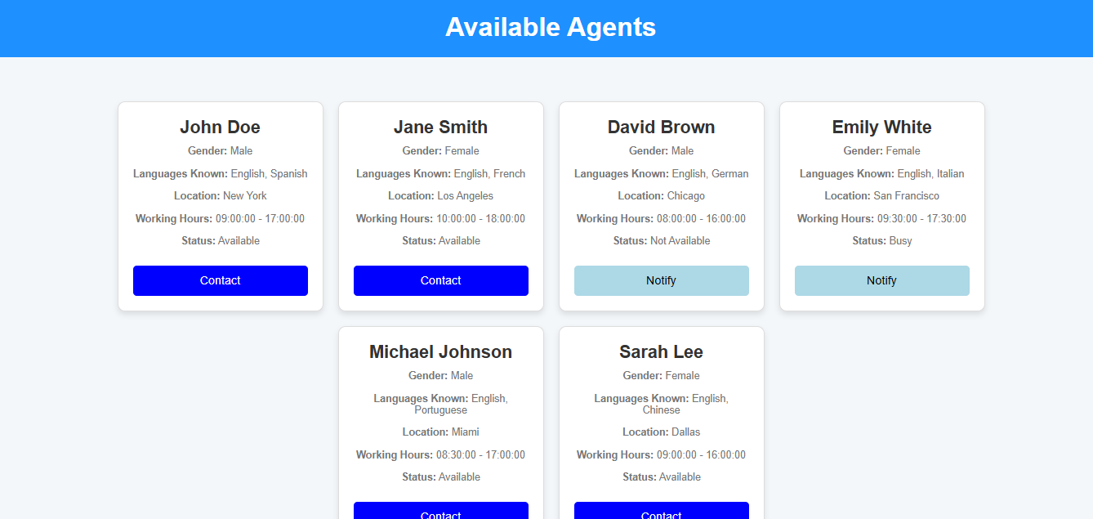
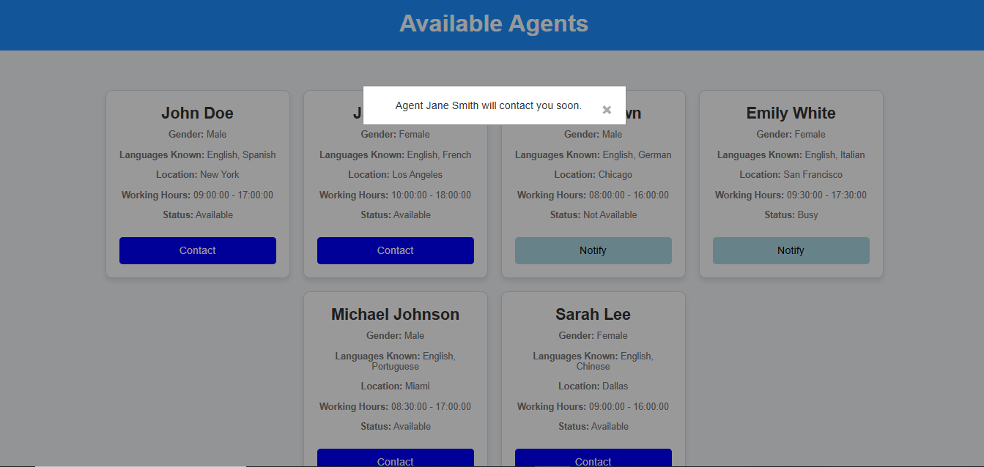
Customer End : Agent Availability

Slide 14
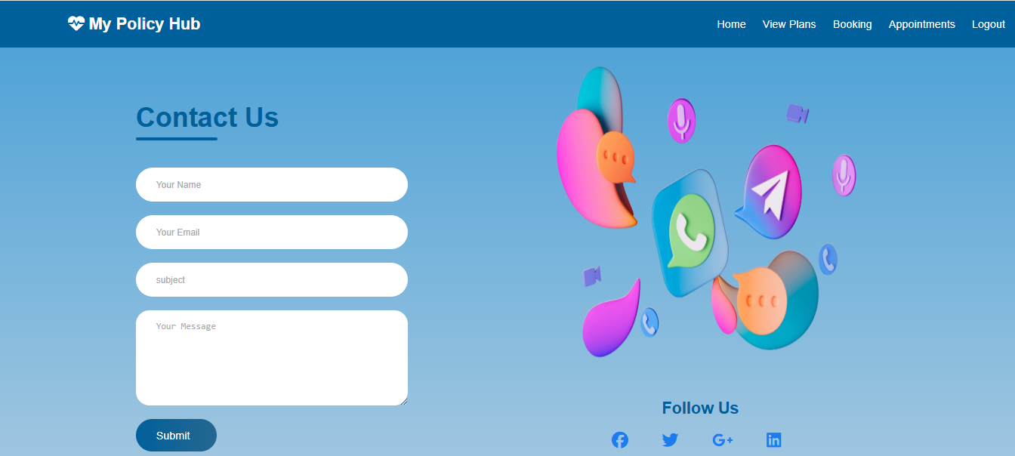
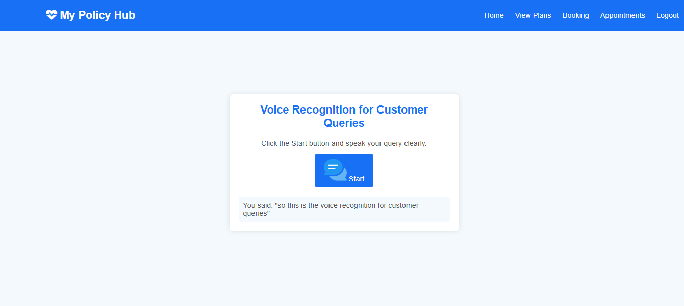
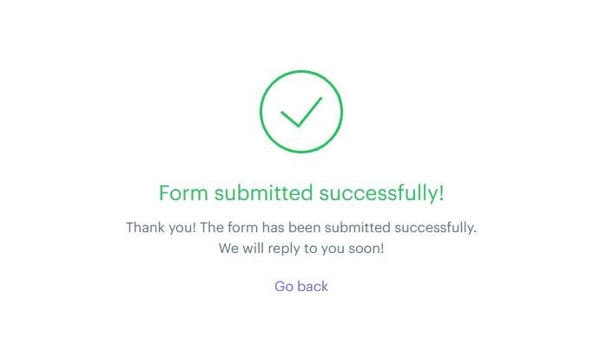
Customer End : Contact Us, Help

Slide 15
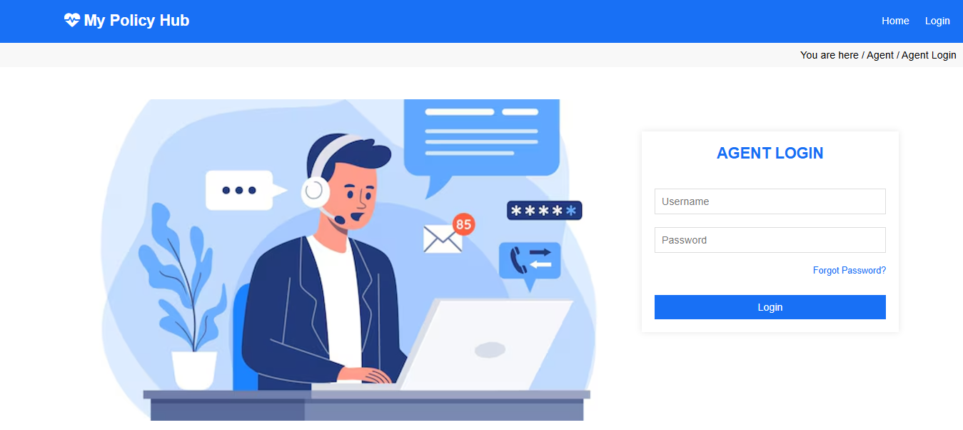
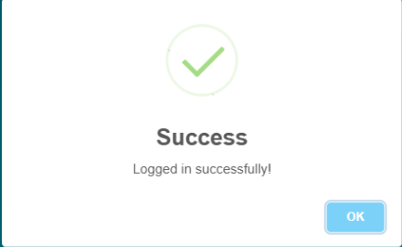
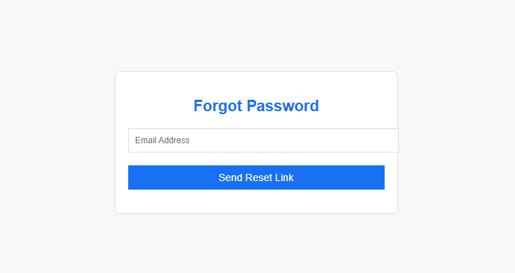
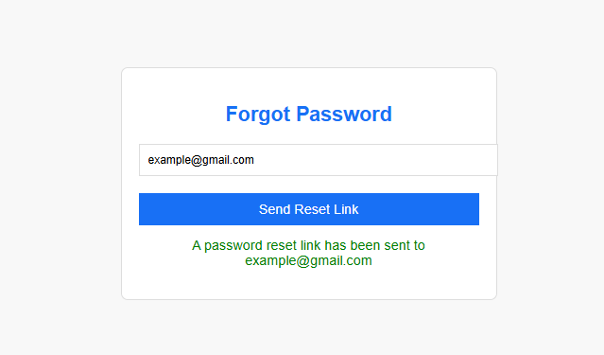

Agent End : Agent Login

Slide 16
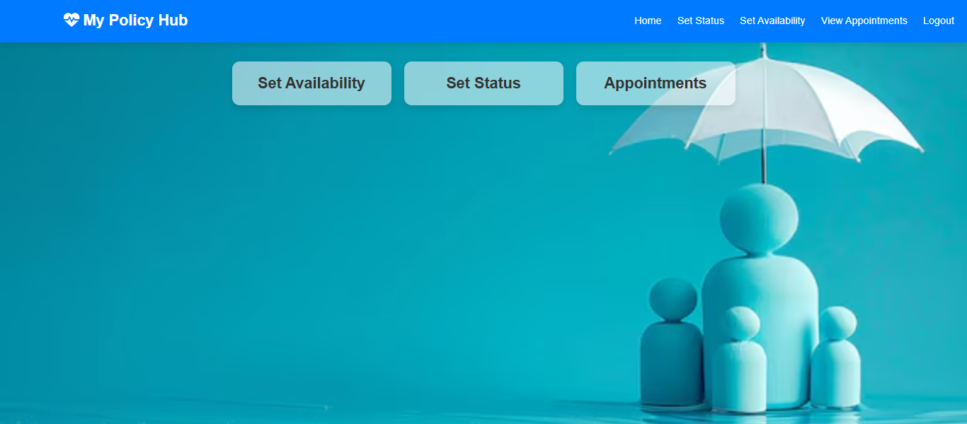
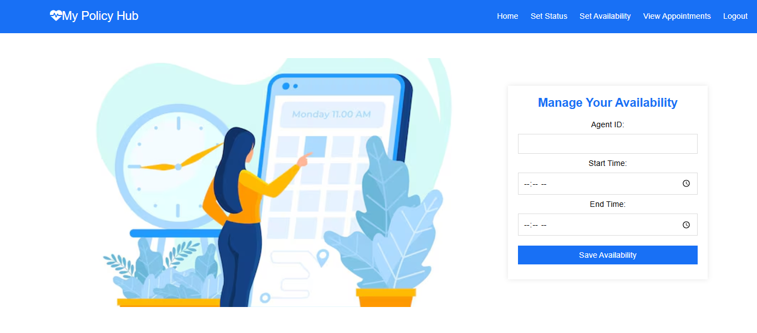
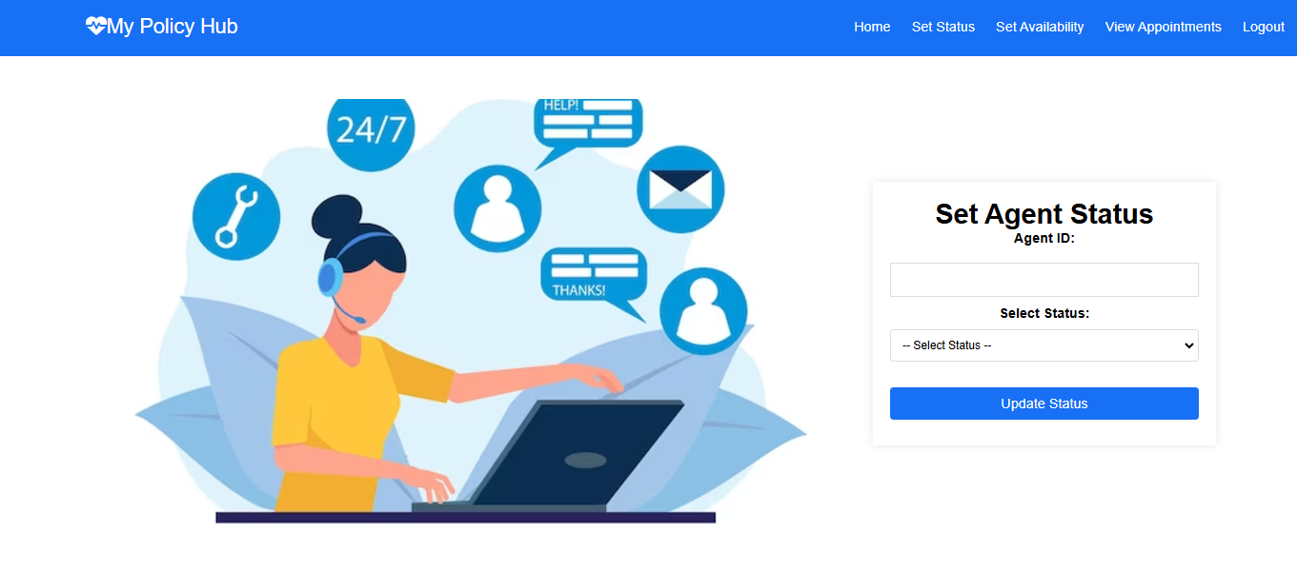
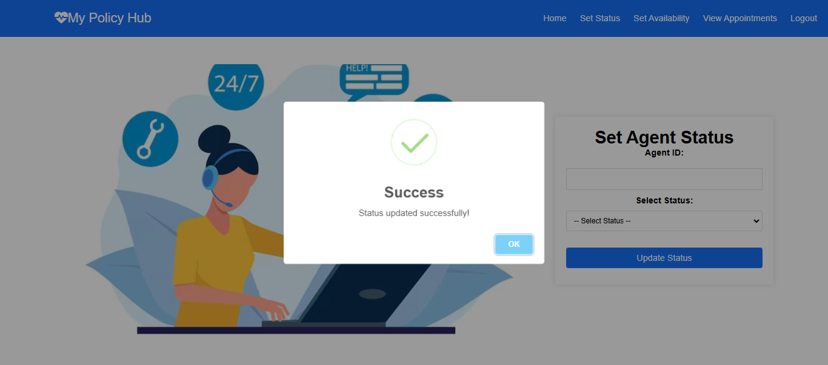
Agent End : Home, Schedule Availability

Slide 17
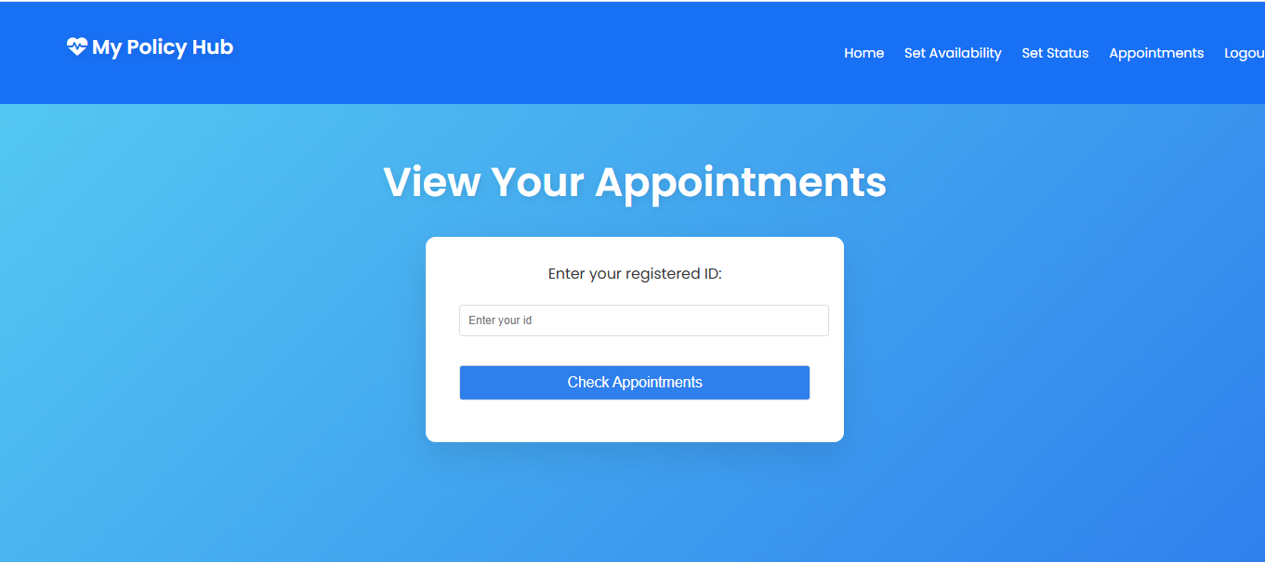
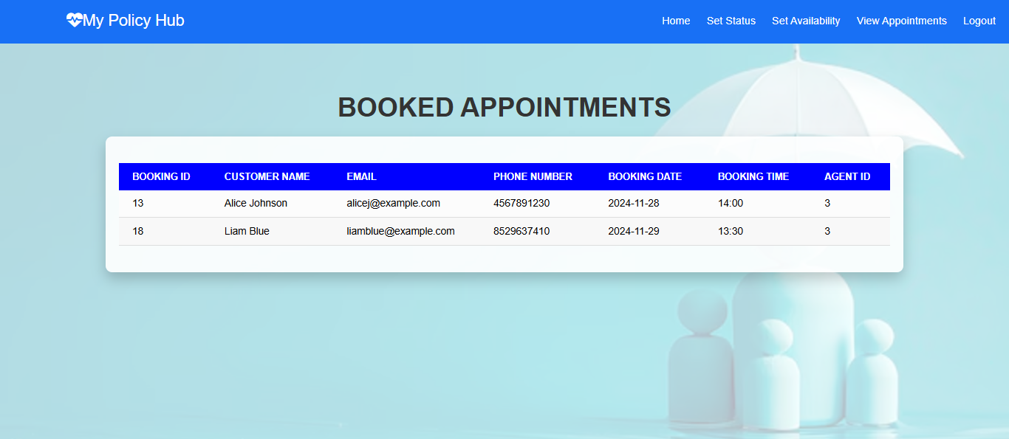
Agent End : View Appointments

Slide 18
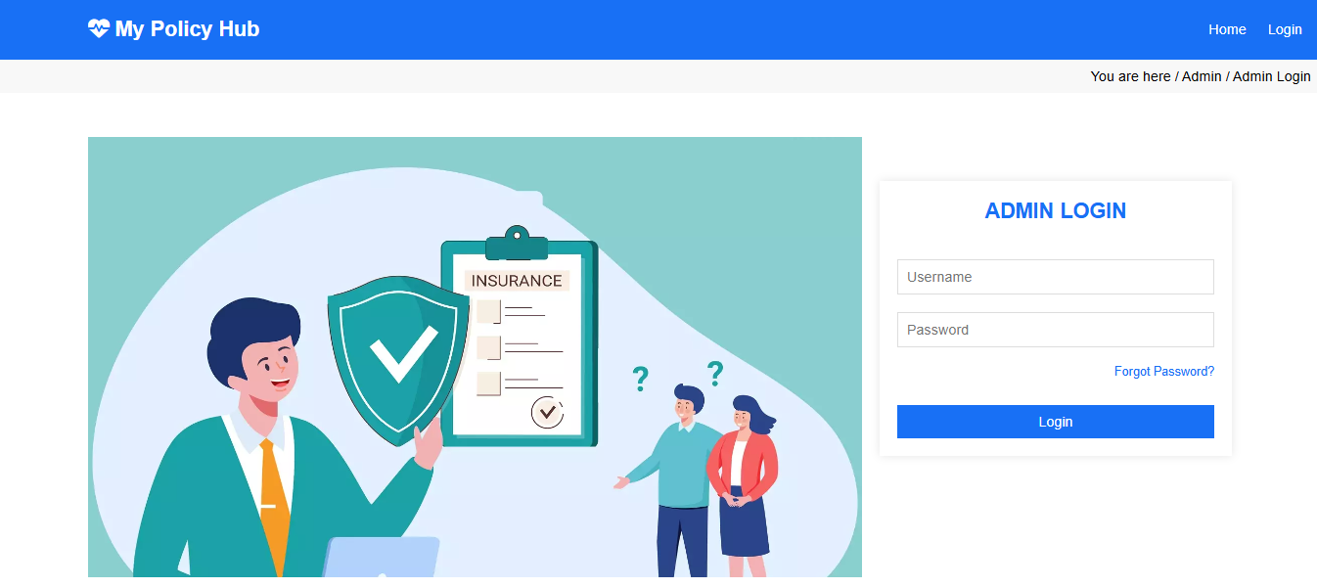
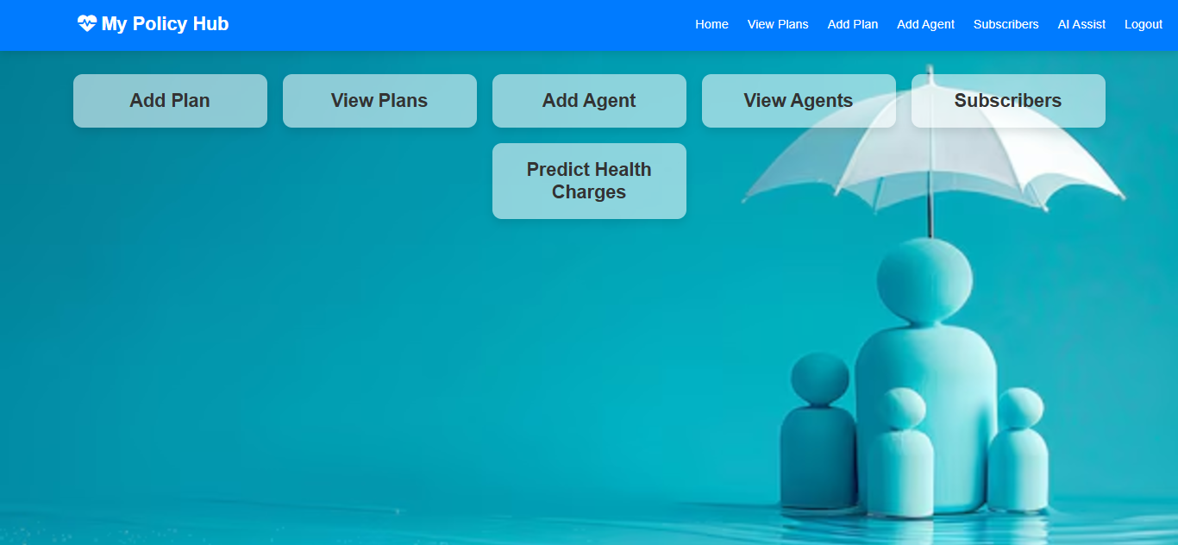
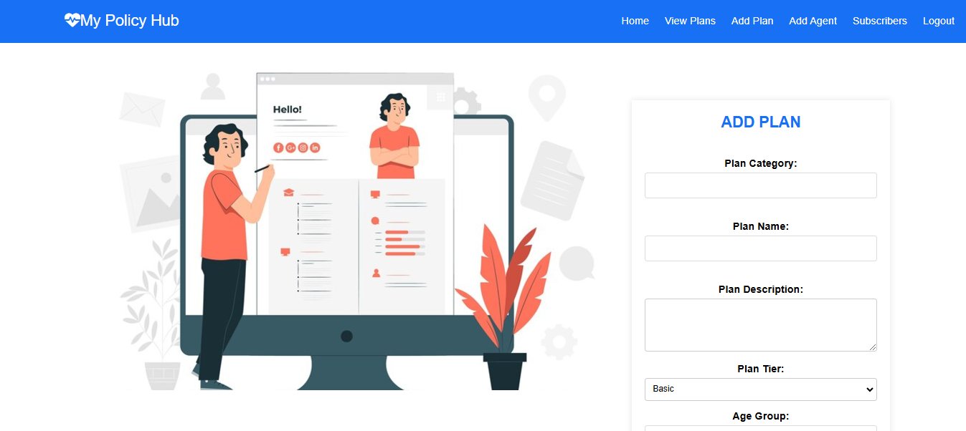
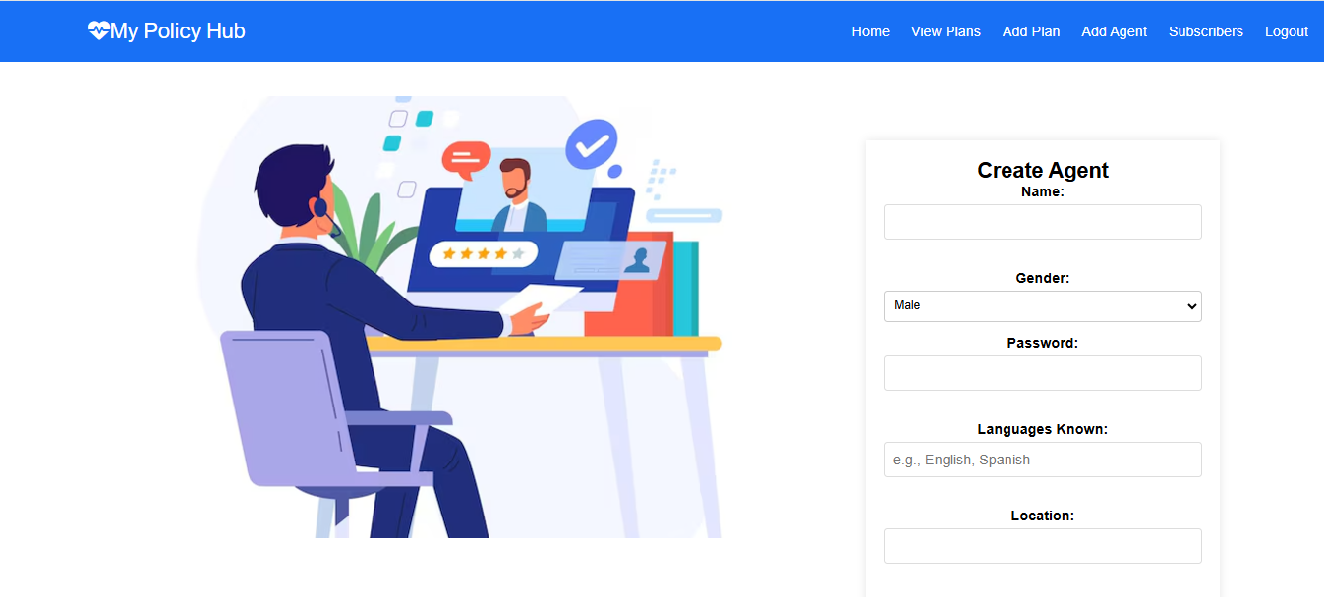
Admin End : Home, Features

Slide 19
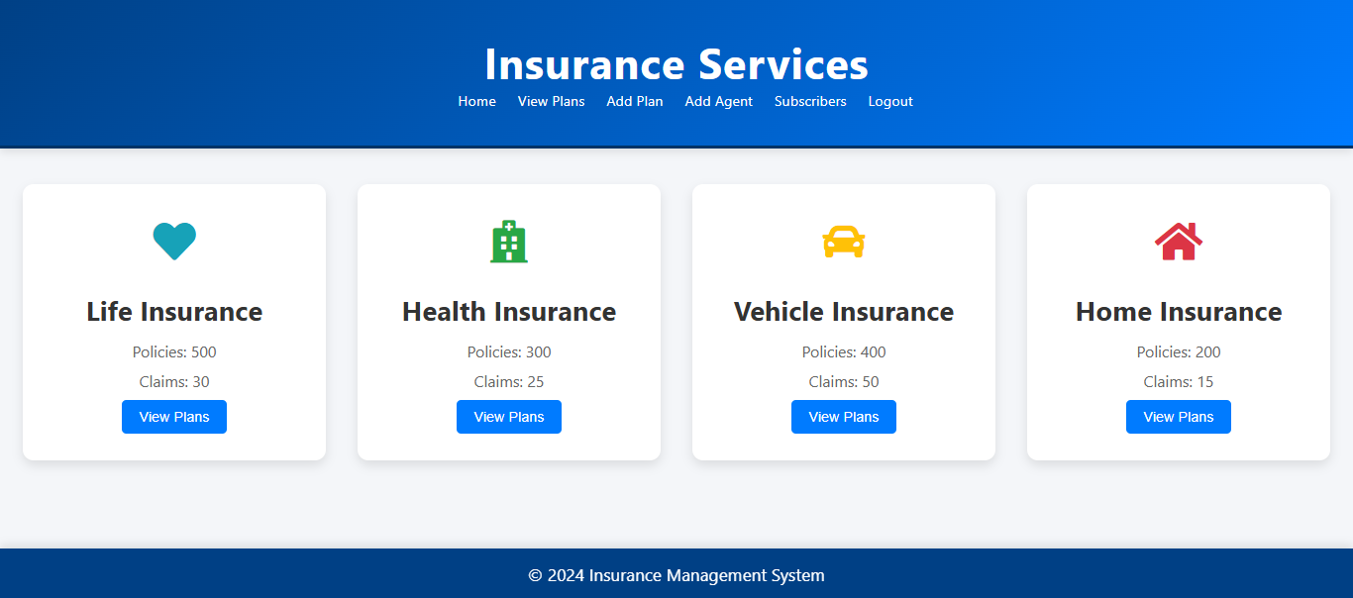
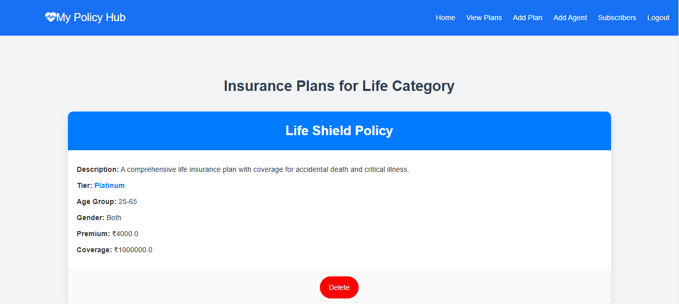
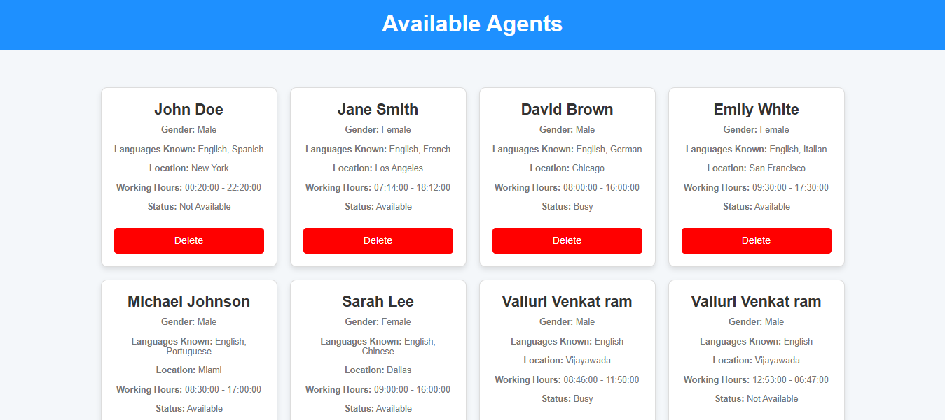
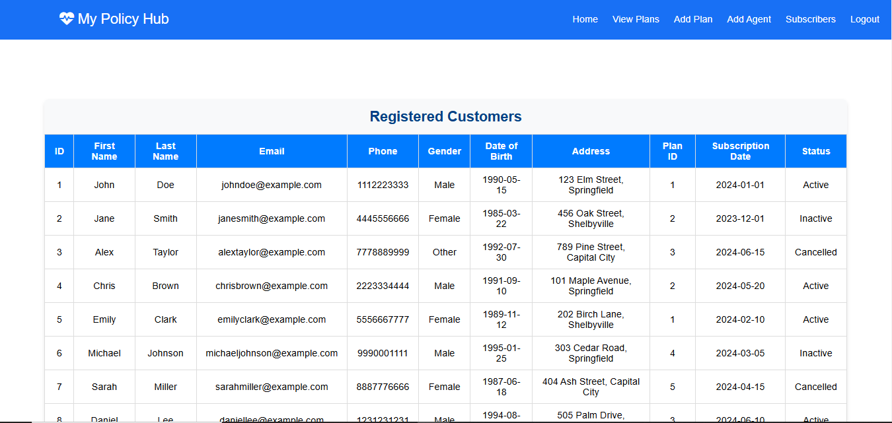
Admin End : Features

Slide 20
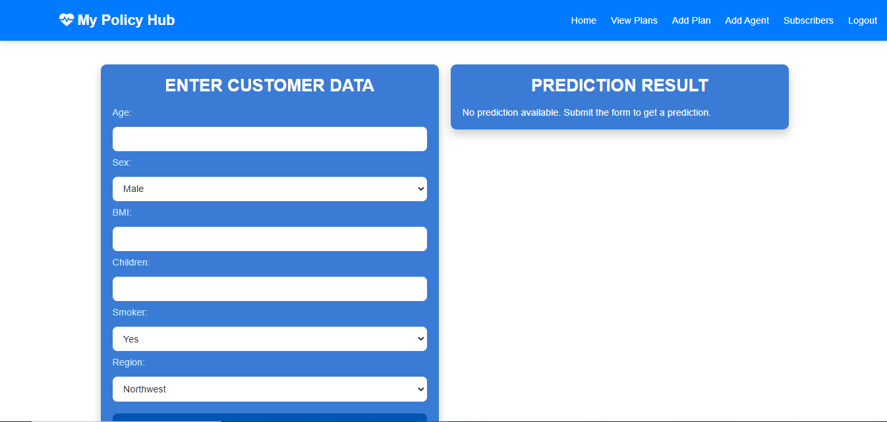

AI Assist – Predict the Health charges

Slide 21
Future Scope
Regional Managers for Admin: Role-based access for managing localized operations.
Enhanced AI Features: Advanced predictive analytics and dynamic risk assessment.
Voice Chat Support: NLP-powered voice chat for improved customer interaction.
Integrated Payment Processing: Seamless transactions with Razorpay or similar gateways.
Real-Time Notifications: Instant SMS and email alerts for updates.
Password Recovery: Secure mechanisms for easy password reset and recovery.

Slide 22



Conclusion
This insurance management application offers a user friendly, secure platform that simplifies insurance processes.
With key features like user authentication, appointment scheduling, and plan management, it enhances both customer experience and operational efficiency.
The admin dashboard allows for streamlined oversight, ensuring easy management of agents, schedules, and plan information.
Overall, this project effectively meets essential needs, improving service efficiency and customer satisfaction.

Slide 23

THANK YOU

